Slide 1
Plant responses to temperature over space and time
February 16, 2021

Slide 2
Class questions
How does temperature vary over space and time?

Slide 4
Class questions
How does temperature change in natural environments?
Why does temperature variation matter for plants?

Slide 6
Processes that respond to temperature: Enzymatic potential

Slide 7
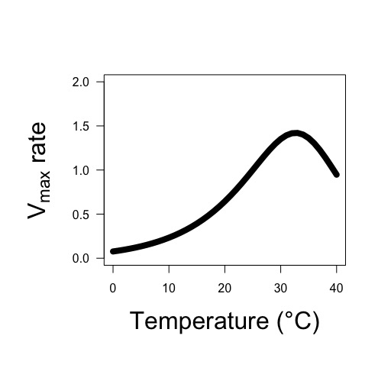
Enzyme rate (Vmax) is the result of both the activation rate and deactivation rate
Leads to a peaked exponential response

Slide 8
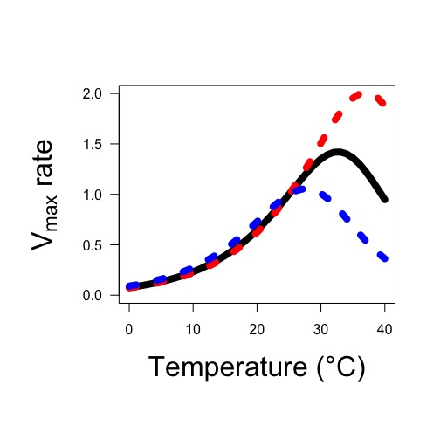
This peak may change based on acclimation
Red = warm acclimated
Blue = cold acclimated

Slide 9
Processes that respond to temperature: Substrate affinity

Slide 10
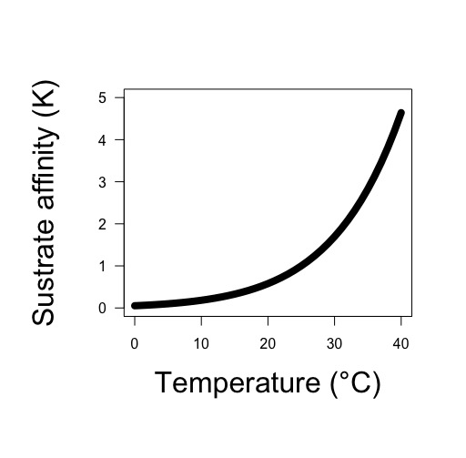
Substrate affinity increases with temperature
The change is dependent on the substrate and enzyme

Slide 11
Processes that respond to temperature: Diffusion

Slide 12
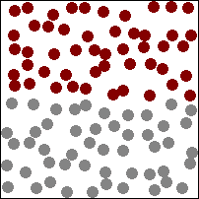
Diffusion: movement from area of low concentration to high concentration

Slide 13
Diffusion rates increase with temperature (Fick’s law coefficient increases)

Slide 14
Class questions
How does temperature change in natural environments?
Why does temperature variation matter for plants?

Slide 16
Respiration and temperature

Slide 17
Respiration and temperature
Enzymatic rates increase with T
Substrate affinity increases with T

Slide 18
Respiration and temperature
Enzymatic rates increase with T
Substrate affinity increases with T
What should the response look like?

Slide 20
Photosynthesis and temperature

Slide 21
Photosynthesis and temperature
Enzymatic rates increase with T
Substrate affinity increases with T

Slide 22
Photosynthesis and temperature
Enzymatic rates increase with T
Substrate affinity increases with T
What should the response look like?

Slide 24
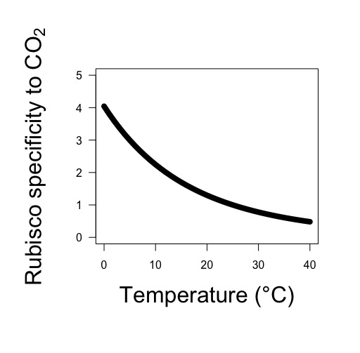
Photosynthesis and temperature
Enzymatic rates increase with T
Substrate affinity increases with T
Rubisco likes O2 more at higher T!

Slide 25
Photosynthesis and temperature
Enzymatic rates increase with T
Substrate affinity increases with T
Rubisco likes O2 more at higher T!
What should the response look like?

Slide 27
Transpiration and temperature

Slide 28
Transpiration and temperature
Diffusion rates increase with T

Slide 29
Transpiration and temperature
Diffusion rates increase with T
What should the response look like?

Slide 31
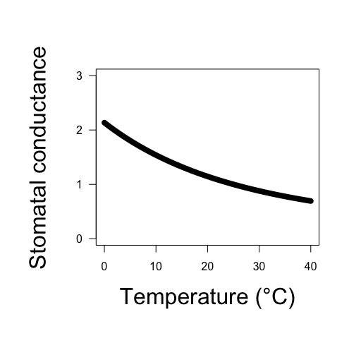
Transpiration and temperature
Diffusion rates increase with T
Stomata close with increased T!

Slide 32
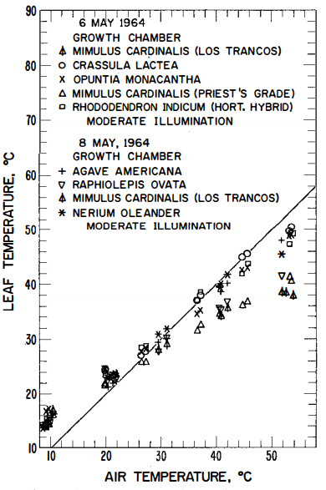
Transpiration and temperature
Diffusion rates increase with T
Stomata close with increased T!
Leaves cool with increased T!
Gates (1968)

Slide 33
Transpiration and temperature
Diffusion rates increase with T
Stomata close with increased T!
Leaves cool with increased T!
What should the response look like?

Slide 35
Does this influence your thinking on photosynthesis-temperature responses?

Slide 36
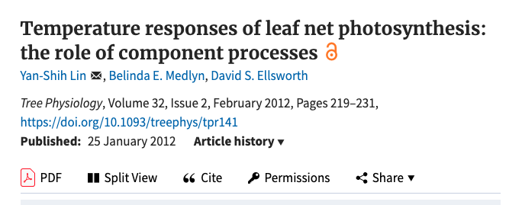

Slide 37
Photosynthesis and temperature
Enzymatic rates increase with T
Substrate affinity increases with T
Rubisco likes O2 more at higher T!
Stomata close at higher T!
What should the response look like?

Slide 39
Photosynthesis and temperature
Enzymatic rates increase with T
Substrate affinity increases with T
Rubisco likes O2 more at higher T!
Stomata close at higher T!
Would this differ for C4 species?

Slide 41
But now what about acclimation!

Slide 42
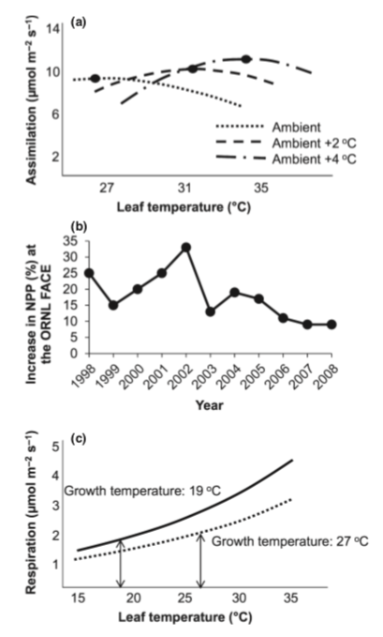
Acclimation leads to a roughly homeostatic response!
Gunderson et al. (2010)
Silim et al. (2010)

Slide 43
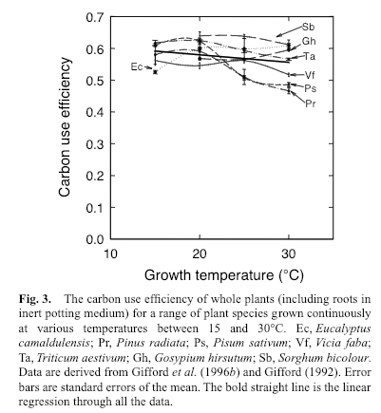
CUE = photosynthesis / respiration
Gifford (2003)

Slide 44
Class questions
How does temperature change in natural environments?
Why does temperature variation matter for plants?
Does any of this even matter?

Slide 45
Will a 3-5°C increase in temperature matter? Why or why not?
IPCC (2013)

Slide 46
Will a 3-5°C increase in temperature matter? Why or why not?

Slide 47
Thermal acclimation and the dynamic response of plant respiration to temperature
Atkin and Tjoelker (2003). Trends in Plant Science

Slide 48
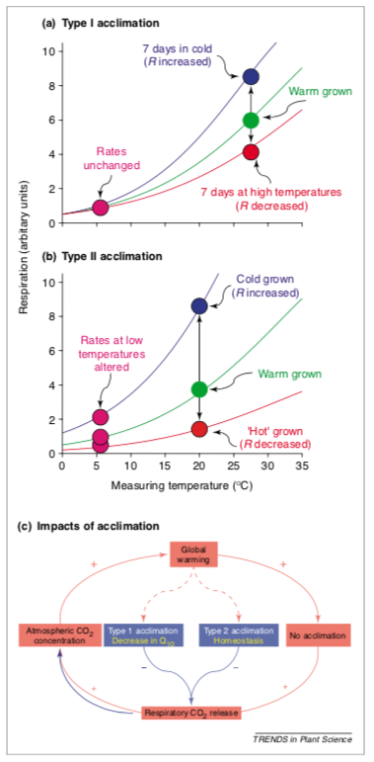
Temperature acclimation: Seems pretty cut and dry!
Atkin & Tjoelker (2003)

Slide 49
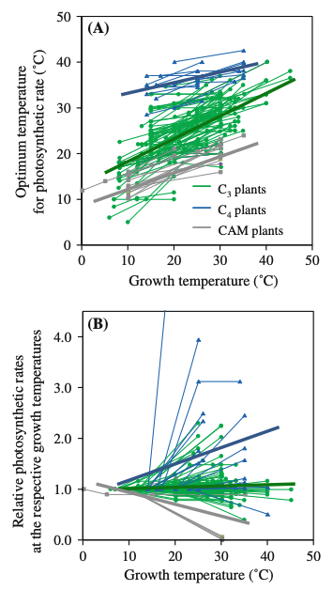
It turns out acclimation can be quite variable
Yamori et al. (2014)

Slide 50
Given what you know about temperature responses: Why would plants acclimate?

Slide 51
Why wouldn’t they?

Slide 52
Figures for ease of viewing

Slide 53
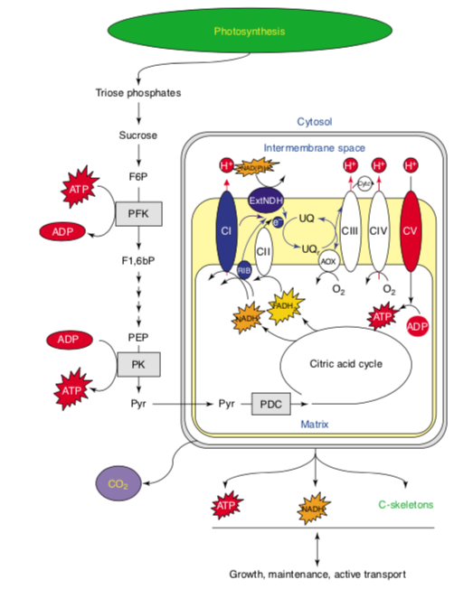

Slide 54
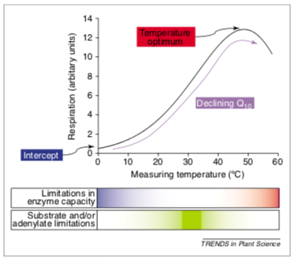

Slide 55
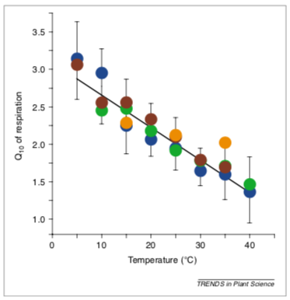

Slide 57
